Slide 2
What is SQL?
SQL is Structured Query Language, which is a computer language for storing, manipulating and retrieving data stored in a relational database that is rows and columns.
SQL is the standard language for Relational Database System.
All the Relational Database Management Systems (RDMS) like MySQL, MS Access, Oracle, Sybase, Informix SQL Server use SQL as their standard database language.

Slide 3
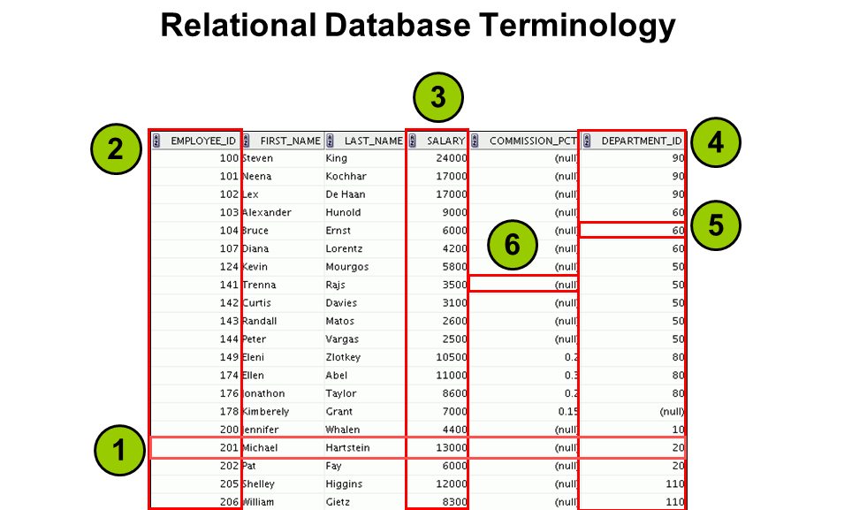

Slide 4
Why SQL?
SQL is required:
To create new databases, tables and views
To insert records in a database
To update records in a database
To delete records from a database
To retrieve data from a database
What SQL does:
With SQL, a user can access data from a RDBMS.
It allows the user to describe the data.
It allows the user to define the data in the database and manipulate it when needed.
It allows the user to create and drop database and table.

Slide 5
What is a table?
The data in an RDBMS is stored in database objects which are called as tables.
table is basically a collection of related data entries and it consists of
numerous columns and rows.
Customer Table:
+----+----------+-----+-----------+----------+----------
| ID | NAME | AGE | ADDRESS | SALARY |
+----+----------+-----+-----------+---------------------+
| 1 | Ramesh | 32 Ahmedabad | 2000.00 |
| 2 | Khilan | 25 | Delhi | 1500.00 |
| 3 | kaushik | 23 | Kota | 2000.00 |
| 4 | Chaitali | 25 | Mumbai | 6500.00 |
| 5 | Hardik | 27 | Bhopal | 8500.00 |
| 6 | Komal | 22 | MP | 4500.00 |
| 7 | Muffy I 24 | Indore | 10000.00 |
+----+----------+-----+-----------+----------+-----------

Slide 6
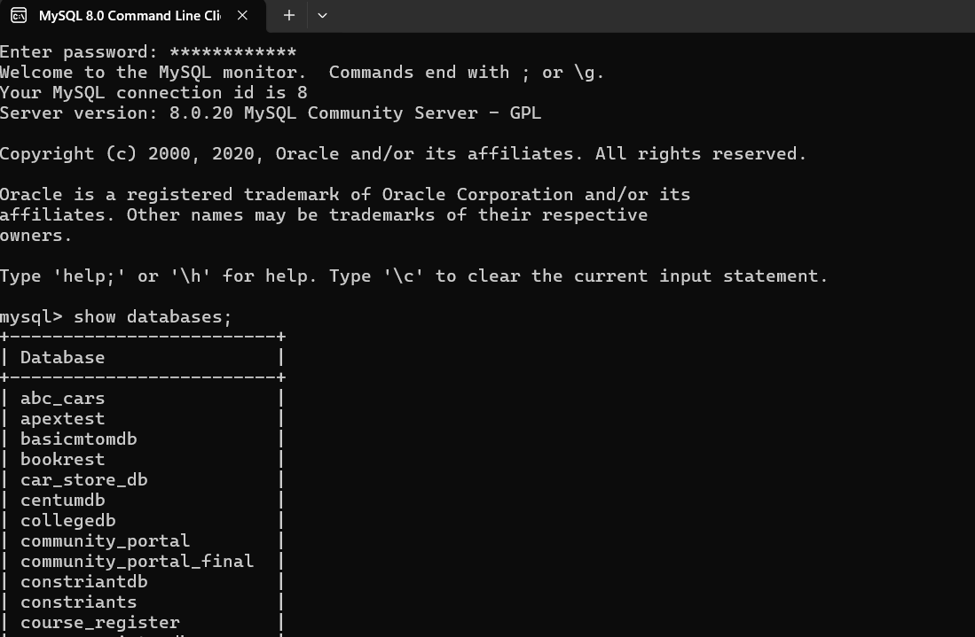
MySQL Command Line

Slide 7
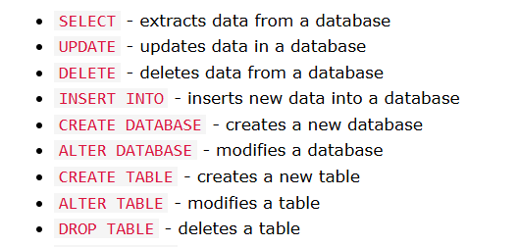
SQL Statement

Slide 8
1. DDL – Data Definition Language
DDL commands are used to define or modify the structure of the database (tables, schemas, etc.).
Common DDL Commands:
CREATE
ALTER
DROP
TRUNCATE

Slide 9
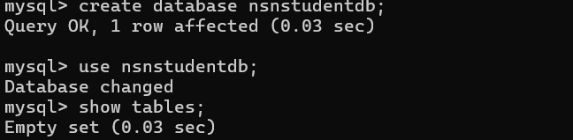
Mysql Database Create / drop
Syntax of Create / Drop Database statement in SQL
CREATE DATABASE Database_Name;
DROP DATABASE Database_Name;
CREATE DATABASE secstudentdb;
SHOW DATABASES ;
SQL Create/Drop Database
DROP DATABASE
DROP DATABASE nsnstudentdb;

Slide 10
-- Create table
CREATE TABLE courses (
course_id INT ,
course_name VARCHAR(20)
);
-- Alter table: Add column
ALTER TABLE courses ADD course_duration INT;
-- Alter table: Modify column
ALTER TABLE courses MODIFY course_name VARCHAR(30);
-- Drop table (delete table structure and data)
DROP TABLE courses;
-- Truncate table (delete only data, not structure)
TRUNCATE TABLE students;

Slide 11
2.DML – Data Manipulation Language
DML commands are used to manipulate data stored in the database (within tables).
Common DML Commands:
INSERT
UPDATE
DELETE
SELECT (Though technically a query, not modifying data)

Slide 12
SQL TABLE
SQL Table variable is used to create, modify, rename,delete tables.
Table variables are used to store a set of records. So declaration syntax generally looks like CREATE TABLE syntax.
create table tablename
("column1" "data type",
"column2" "data type",
...
"columnN" "data type");

Slide 13
-- Create a sample table
CREATE TABLE students (
id INT ,
name VARCHAR(50),
department VARCHAR(50)
);
-- Insert data (INSERT)
INSERT INTO students (id, name, department) VALUES (1, 'Arun', 'CSE');
INSERT INTO students (id, name, department) VALUES (2, 'Divya', 'ECE');
-- Update data (UPDATE)
UPDATE students SET department = 'IT' WHERE name = 'Divya';
-- Delete data (DELETE)
DELETE FROM students WHERE id = 1;
-- Select data (SELECT)
SELECT * FROM students;

Slide 14
Problem Statement
Create a MySQL database and a student table to store student academic details.
The student table should contain:
  StudentId - int
  FirstName - varchar(20)
  Address – varchar(20)
  Age - int
  Percentage -int
  Grade – varchar(20)
Perform the following operations:
Create a database as CollegeDB
Create the studenttb table using DDL.
Insert student records using DML.
Display all student records.
Update a student's percentage and grade.
Delete a student record.
Add a new column using ALTER TABLE Department varchar(20)
Display the final student table.
Drop table Studenttb table and CollegeDB

Slide 15
Sample Input & Output
StudentId | FirstName | Address | Age | Percentage | Grade
101 | Arun | Chennai | 20 | 85 | A
102 | Priya | Madurai | 21 | 92 | A+
103 | Kavin | Salem | 20 | 76 | B
104 | Divya | Coimbatore | 21 | 88 | A
105 | Rahul | Trichy | 22 | 65 | C
StudentId | FirstName | Address | Age | Percentage | Grade | Department
101 | Arun | Bangalore | 20 | 85 | A | CSE
102 | Priya | Madurai | 21 | 92 | A+ | ECE
103 | Kavin | Salem | 20 | 82 | A | IT
104 | Divya | Coimbatore | 21 | 88 | A | AIML
106 | Meena | Erode | 20 | 79 | B | CSE

Slide 16
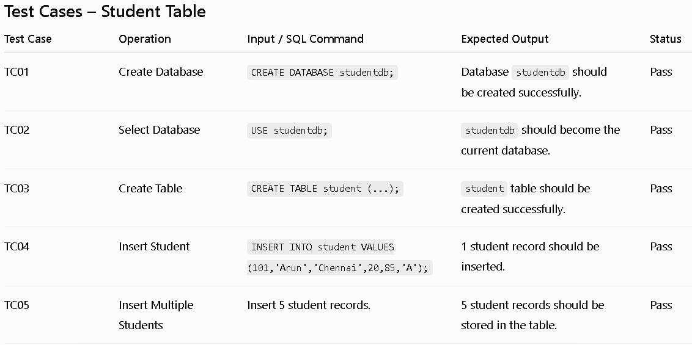
Test Cases – Student Table

Slide 17
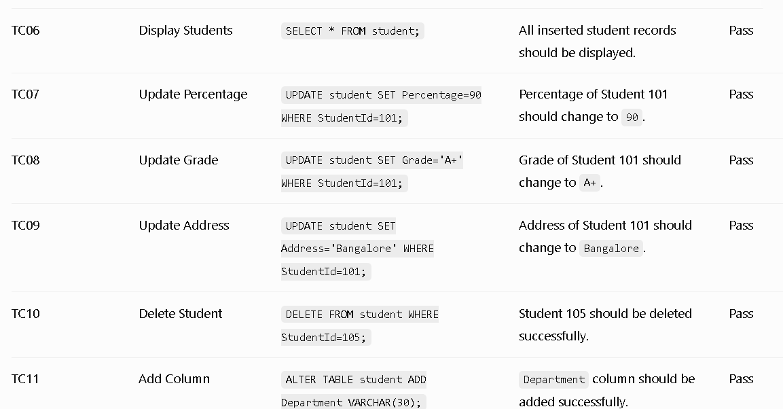

Slide 18
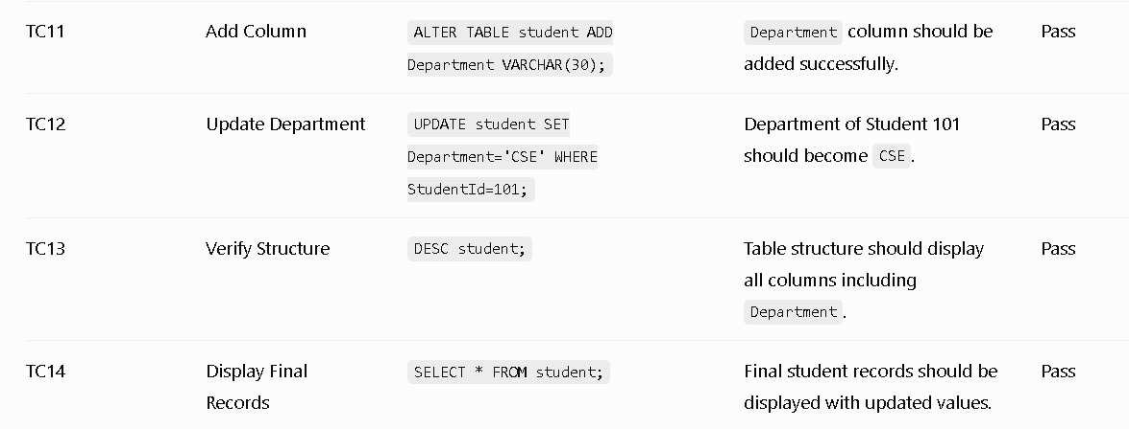

Slide 20
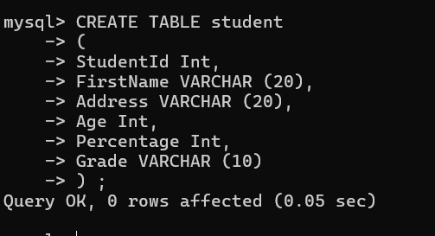
SQL Table
CREATE TABLE student
(
StudentId Int,
FirstName VARCHAR (20),
Address VARCHAR (20),
Age Int,
Percentage Int,
Grade VARCHAR (10)
) ;

Slide 21
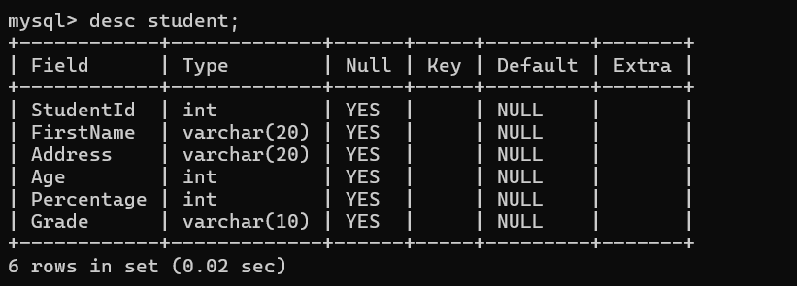
Describe
UPDATE student SET Department = 'CSE' WHERE StudentId = 101;

Slide 22
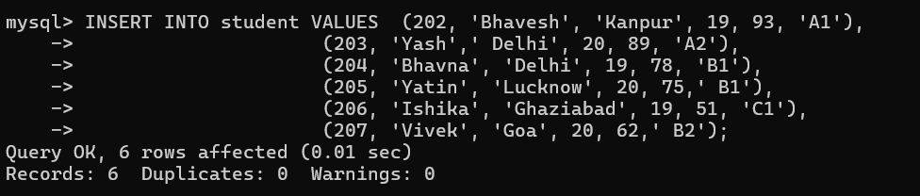
Insert data into table
insert Single Record into Student table:
INSERT INTO student VALUES (201, 'Akash',' Delhi', 18, 89, 'A2');
insert multiple record at a time in Student table:
INSERT INTO student VALUES (202, 'Bhavesh', 'Kanpur', 19, 93, 'A1'),
(203, 'Yash',' Delhi', 20, 89, 'A2'),
(204, 'Bhavna', 'Delhi', 19, 78, 'B1'),
(205, 'Yatin', 'Lucknow', 20, 75,' B1'),
(206, 'Ishika', 'Ghaziabad', 19, 51, 'C1'),
(207, 'Vivek', 'Goa', 20, 62,' B2');

Slide 23
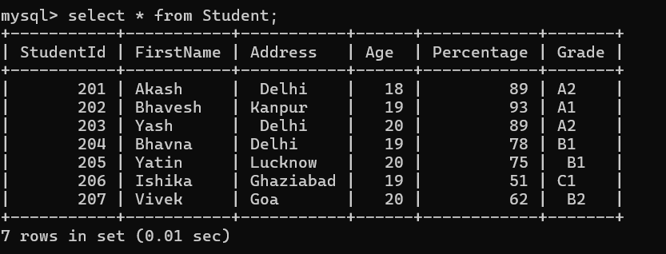
Select all record or data :

Slide 24
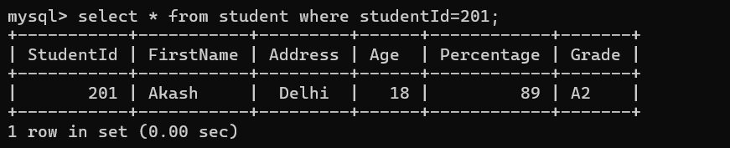
Select Command
select particular record using where condition :
select * from student where studentId=201;

Slide 25
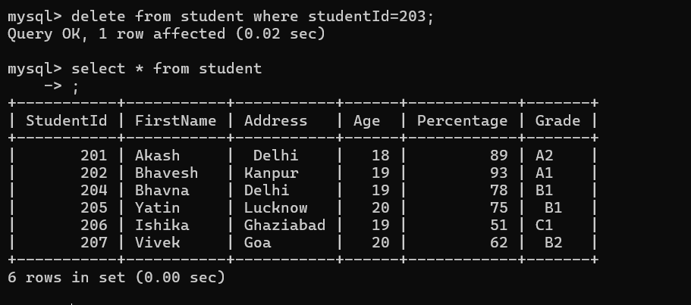
delete particular record:
The DELETE statement is used to delete existing records in a table.
DELETE Syntax
DELETE FROM table_name WHERE condition;
delete from student where studentId=203;
delete all record:
delete * from student;

Slide 26
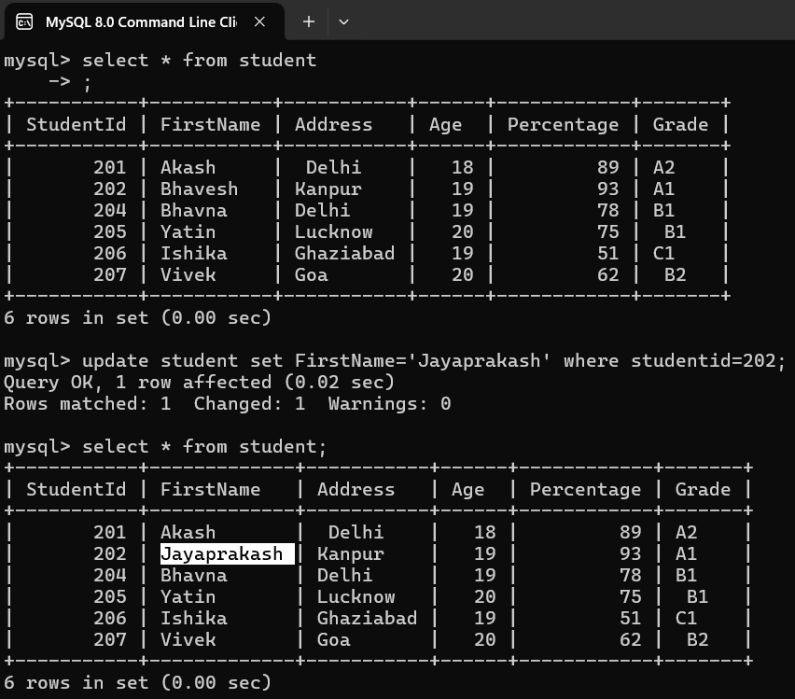
update particular data from database:
update student set FirstName='Jayaprakash' where studentid=202;

Slide 27
drop table
drop table student;

Slide 29
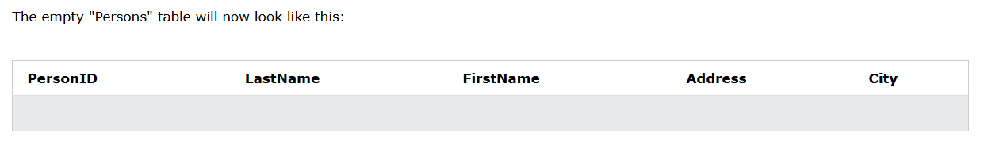
Another Table
CREATE TABLE Persons (
PersonID int,
LastName varchar(255),
FirstName varchar(255),
Address varchar(255),
City varchar(255)
);

Slide 30
MySQL DROP TABLE Statement
The DROP TABLE statement is used to drop an existing table in a database.
Syntax
DROP TABLE table_name;
drop table Person;

Slide 31
SQL ALTER TABLE
ALTER TABLE statement in Structured Query Language allows you to add, modify, and delete columns of an existing table.
This statement also allows database users to add and remove various SQL constraints on the existing tables.
ALTER TABLE ADD Column statement in SQL
ALTER TABLE table_name ADD column_name column-definition;
alter table student add city varchar(40);
ALTER TABLE MODIFY Column statement in SQL - pending
ALTER TABLE table_name MODIFY column_name column-definition;
alter table student modify address varchar(50);

Slide 32
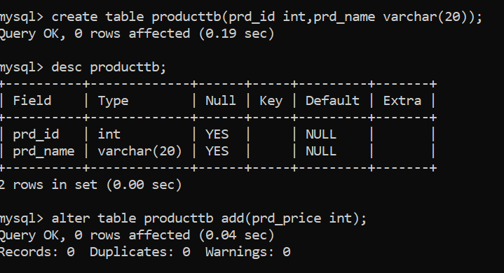
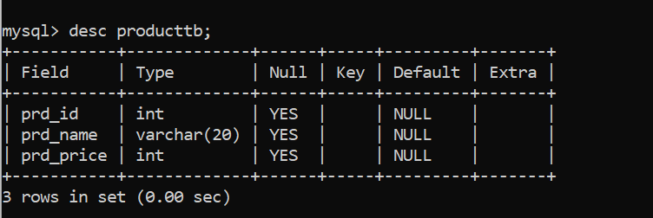
SQL ALTER TABLE – Add column

Slide 33
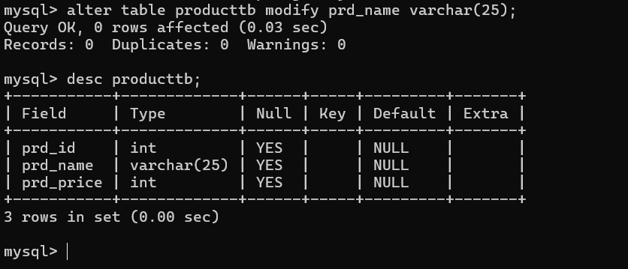
SQL ALTER TABLE - Modify

Slide 34
Rename
To rename a table in MySQL, you can use the RENAME TABLE or ALTER TABLE command.
Using RENAME TABLE:
RENAME TABLE old_table_name TO new_table_name;
rename a table named users to customers:
RENAME TABLE users TO customers;

Slide 35
Renaming multiple tables with RENAME TABLE:
Synax:
rename tables products to items and orders to purchases:
RENAME TABLE products TO items, orders TO purchases;
DELETE vs TRUNCATE
DELETE is a SQL command that removes one or multiple rows from a table using conditions. Using rollback retrieve back in a transaction
TRUNCATE is a SQL command that removes all the rows from a table without using any condition cannot do rollback
TRUNCATE TABLE employees;

Slide 36
TCL
COMMIT command
COMMIT command is used to permanently save any transaction into the database.
When we use any DML command like INSERT, UPDATE or DELETE, the changes made by these commands are not permanent, until the current session is closed, the changes made by these commands can be rolled back.
To avoid that, we use the COMMIT command to mark the changes as permanent.
Mysql>commit;
ROLLBACK command
This command restores the database to last commited state.
mysql>rollback

Slide 38
DDL – Data Definition Language
Problem Statement:
Create a database named CompanyDB and a table Employee to store employee details .Perform structure-related operations like create, alter, and drop.
Column empid,empname, department, salary decimal(10,2),
joindate DATE

Slide 39
Queries
Step 1: Create Database
CREATE DATABASE CompanyDB;
USE CompanyDB;
Step 2: Create Table (No Primary Key)
CREATE TABLE Employee (
emp_id INT,
emp_name VARCHAR(50),
department VARCHAR(30),
salary DECIMAL(10,2),
join_date DATE
);

Slide 40
Step 3: Add a Column (email)
ALTER TABLE Employee ADD COLUMN email VARCHAR(100);
Step 4: Modify Column Data Type
ALTER TABLE Employee MODIFY COLUMN salary DECIMAL(12,2);
Step 5: Drop a Column (email)
ALTER TABLE Employee DROP COLUMN email;
Step 6: View Table Structure
DESC Employee;
Step 7: Drop Table
DROP TABLE Employee;

Slide 41
Desc employee
Field | Type | Null | Key | Default | Extra
emp_id | int | YES |  | NULL
emp_name | varchar(50) | YES |  | NULL
department | varchar(30) | YES |  | NULL
salary | decimal(12,2) | YES |  | NULL
join_date | date | YES |  | NULL

Slide 42
DML – Data Manipulation Language
Problem Statement 2:
Insert, update, delete, and retrieve employee records from the Employee table.
Problem Statement 3: Display Employee Records
Write an SQL query to display all employee records from the Employee table.
Problem Statement 4: Update Employee Salary
Write an SQL query to update Bob's salary to 58000.00.
Problem Statement 5: Delete Employee Record
Write an SQL query to delete the employee record of Alice.
Problem Statement 6: Employees with Salary Greater Than 55000
Write an SQL query to display employee details whose salary is greater than 55000.
Problem Statement 7: Sort Employees by Salary
Write an SQL query to display employee names and salaries in descending order of salary.

Slide 43
Step 2: Insert Employee Data
INSERT INTO Employee (emp_id, emp_name, department, salary, join_date)
VALUES
(101, 'Alice', 'HR', 45000.00, '2022-01-10'),
(102, 'Bob', 'IT', 55000.00, '2021-11-20'),
(103, 'Charlie', 'Finance', 60000.00, '2023-03-15'),
(104, 'David', 'IT', 70000.00, '2023-06-01');

Slide 44
Step 3: Display All Records
SELECT * FROM Employee;
Step 4: Update Salary of Bob
UPDATE Employee SET salary = 58000.00 WHERE emp_name = 'Bob’;
Step 5: Delete Employee “Alice”
DELETE FROM Employee WHERE emp_name = 'Alice’;
Step 6: Retrieve Employees With Salary > 55000
SELECT emp_name, department, salary FROM Employee WHERE salary > 55000;
Step 7: Sort Employees by Salary (Descending)
SELECT emp_name, salary FROM Employee ORDER BY salary DESC;

Slide 45
Sample Input / Output
Input (After Insertion)
emp_id | emp_name | department | salary | join_date
101 | Alice | HR | 45000.00 | 2022-01-10
102 | Bob | IT | 55000.00 | 2021-11-20
103 | Charlie | Finance | 60000.00 | 2023-03-15
104 | David | IT | 70000.00 | 2023-06-01
Output (After Update & Delete)
emp_id | emp_name | department | salary | join_date
102 | Bob | IT | 58000.00 | 2021-11-20
103 | Charlie | Finance | 60000.00 | 2023-03-15
104 | David | IT | 70000.00 | 2023-06-01

Slide 46
COMPANY – EMPLOYEE MYSQL TCL PRACTICE SHEET
About TCL
TCL (Transaction Control Language) commands manage transactions in a database.
They control how and when data modifications are saved or undone.
Command Purpose
COMMIT Save all changes permanently
ROLLBACK Undo changes made in the current transaction
SAVEPOINT Set a point within a transaction to roll back to
SET AUTOCOMMIT Enable or disable auto-commit mode

Slide 47
Problem Statement
You are managing the Employee table in the CompanyDB database.
You must perform insert, update, and delete operations with transaction control
(using COMMIT, ROLLBACK, and SAVEPOINT).
Initial Setup
Use the existing database and table (no primary key):
USE CompanyDB;
CREATE TABLE Employee (
emp_id INT,
emp_name VARCHAR(50),
department VARCHAR(30),
salary DECIMAL(10,2),
join_date DATE
);

Slide 48
Step-by-Step TCL Operations
Disable Auto Commit
By default, MySQL automatically commits after every statement.
We disable it to control transactions manually.
SET AUTOCOMMIT = 0;
Now changes will not be saved automatically.

Slide 49
Insert Sample Records
INSERT INTO Employee (emp_id, emp_name, department, salary, join_date)
VALUES
(201, 'Arun', 'IT', 50000.00, '2023-01-10'),
(202, 'Bala', 'HR', 45000.00, '2023-02-05'),
(203, 'Chitra', 'Finance', 55000.00, '2023-03-12’);
Data inserted, but not yet saved permanently.

Slide 50
Save Transaction (COMMIT)
COMMIT;
All above inserts are now permanently saved.
Update with SAVEPOINT
UPDATE Employee SET salary = 60000 WHERE emp_name = 'Arun';
SAVEPOINT BeforeDelete;
Created a savepoint “BeforeDelete”.

Slide 51
Delete a Record
DELETE FROM Employee WHERE emp_name = 'Bala';
Record deleted temporarily (not yet committed).
Rollback to Savepoint
ROLLBACK TO BeforeDelete;
Undo deletion — Bala’s record restored.

Slide 52
Commit Final Changes
COMMIT;
All changes up to this point are permanently saved.
Enable Auto Commit Again
SET AUTOCOMMIT = 1;

Slide 53
Command | Function | Example
SET AUTOCOMMIT = 0; | Turn off auto-commit | Disable auto save
COMMIT; | Save all changes | COMMIT;
ROLLBACK; | Undo changes | ROLLBACK;
SAVEPOINT sp1; | Create a rollback point | SAVEPOINT BeforeDelete;
ROLLBACK TO sp1; | Undo up to savepoint | ROLLBACK TO BeforeDelete;
DDL – Table created
DML – Data inserted/updated
DCL – User privileges controlled
TCL – Transaction handled safely

